Slide 1
Introduction
Lecture 1
Course leader: Oleg Sysoev

Slide 2
Course topics
Introduction to Time Series.
Time series regression and explorative analysis
ARIMA models
AR, MA, ARMA, ARIMA, seasonal ARIMA
Model selection
Estimation
Forecasting
Spectral Analysis
GARCH models and threshold models

Slide 3
Course organization
Lectures
Available at LISAM
Teaching sessions
Labs
Available at LISAM, under ’Submissions’
Work in pairs
Send your report via LISAM
Deadlines
Written assignments
No submission needed – keys are given

Slide 4

Course organization
Seminars
Help with written assignments
Questions about lab assignments
Questions about lecture material
Examination
Written exam
Submission of lab reports

Slide 5
Course organization
Software: R
https://www.r-project.org/
https://www.rstudio.com/
Define your groups (2 persons) this week:
https://docs.google.com/spreadsheets/d/1oL4zuiJJKUMWI28Q9uI4oCFGzhAIUEKiDoaC90s68IY/edit?usp=sharing
Difficult to find a group? Put your name in some cell.. I will merge you to someone

Slide 6
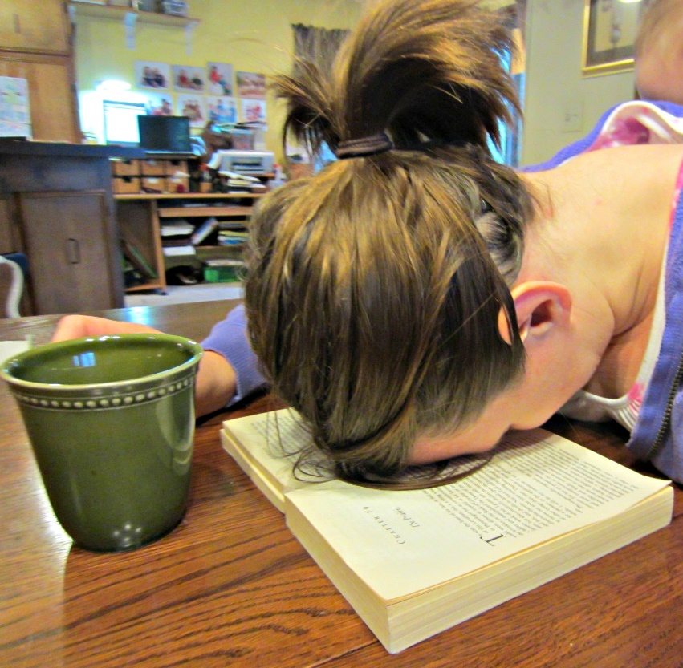
Course organization
Course books
Main book
’Time Series Analysis and its applications’ by Shumway and Stoffer. Fourth Edition (2017). ISBN 978-3-319-52451-1
Do not skip examples when you read!
First 2 chapters are easy, but don’t relax!
Secondary book
’Time Series analyis’ by Cryer and Chan. Second Edition (2008). ISBN 9878-0-387-75958-6
Wordpress.com

Slide 7
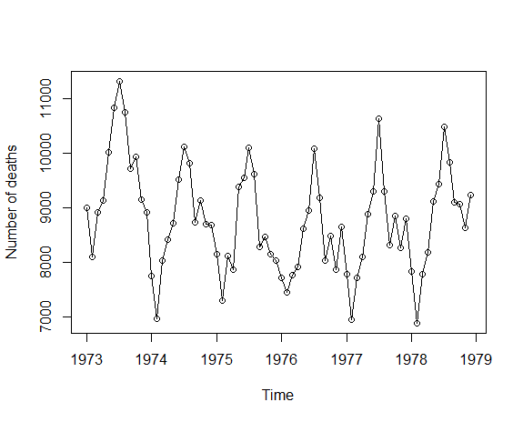
Time Series Analysis
Usual regression analysis
Often: observations are iid
Time Series Analysis
Observations are correlated
Time is often on an integer scale

Slide 8
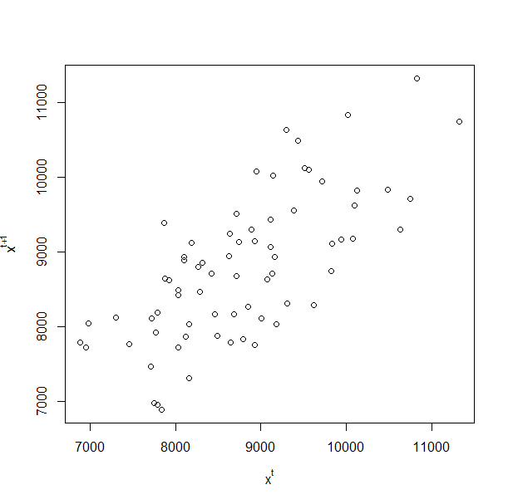

Time Series Analysis
See connection between $x_{t}$ and $x_{t+1}$

Slide 9
Time Series Analysis
Applications
Economics
Social Sciences
Telecommunications
Medicine
Physics
Business
…

Slide 10
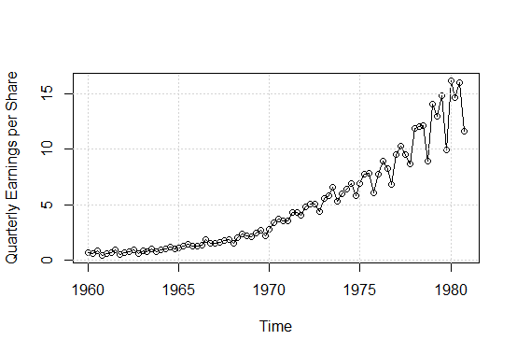
Example 1
Johnson & Johnson quarterly earnings
What can you see?
Trend?
Constant
Linear
Other
Variation?
Seasonality?
Outliers?

Slide 11
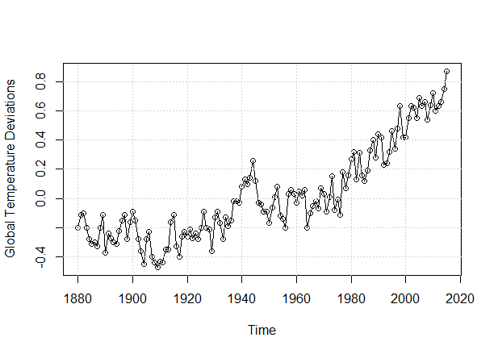
Example 2
Global warming
What can you see here?
Trend is of interest

Slide 12
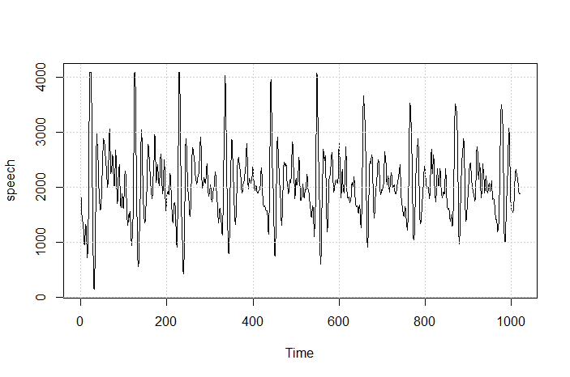
Example 3
Speech data
What can you see here?
Pattern of periodicity is of interest→ decompose signal into different frequences

Slide 13
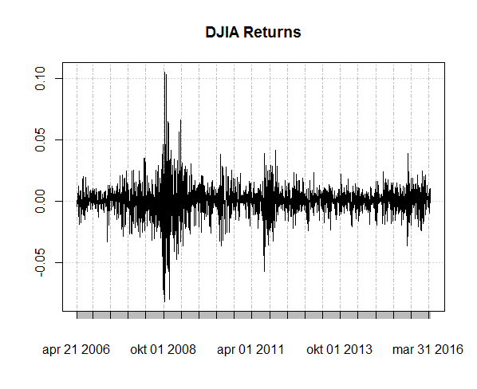
Example 4
Dow Jones Industrial Average
What can you see here?
Pattern of variation is of interest → GARCH models

Slide 14
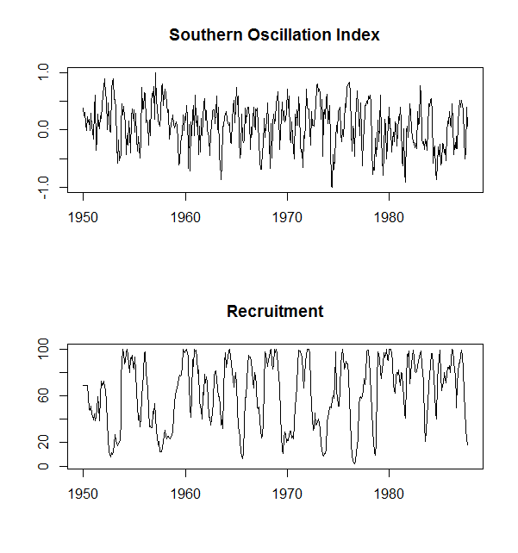
Example 5
El nino and fish population
Are those related?
Can we use one to predict another one?
Transfer function modeling

Slide 15
The Big Picture
Time series analysis
Time Domain
ARIMA models
GARCH models
Transfer function models
Frequency domain
Spectral estimation
Filtering
Can be applied to same kind of data!

Slide 16
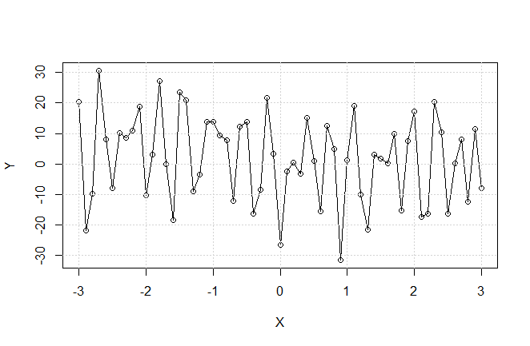
Frequency domain: example
$$Y=4\cos\left(X+2\right)+13\cos\left(20X+4\right)+20\cos\left(0.2X+1\right)+13\cos\left(0.5X−4\right)+N(0,0.5)$$
No sin() or cos() are evident from the picture
Can we restore original frequencies?
Can we account for the noise?

Slide 17
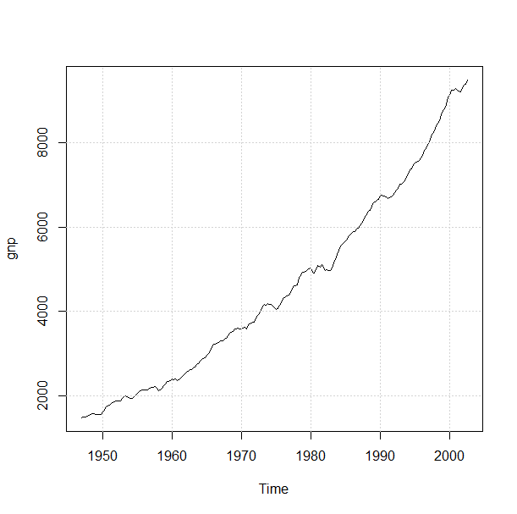
Time domain: The Big Picture
Time Series data
Exploratory data analysis

Slide 18
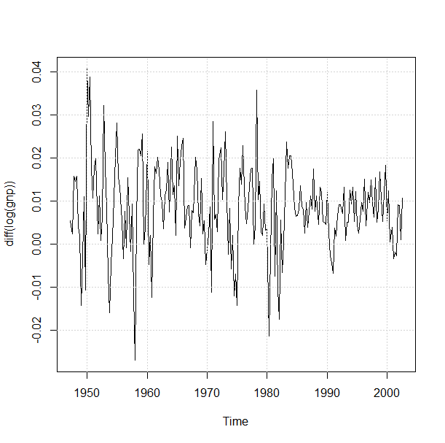

Time domain: The Big Picture
Time Series data
$$Y_{t}=∇\left(\log\left(X_{t}\right)\right)$$
Exploratory data analysis
Make data stationary

Slide 19
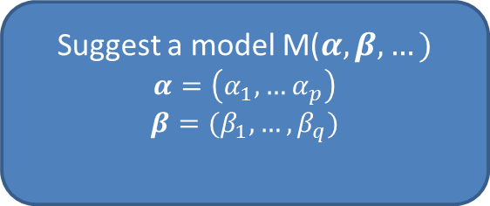
Time domain: The Big Picture
Time Series data
Exploratory data analysis
Make data stationary
Suggest a model M($α, β,…)$
$$α=\left(α_{1},…α_{p}\right)$$
$$β=(β_{1},…, β_{q})$$

Slide 20


Time domain: The Big Picture
Suggest a model M($α, β,…)$
$$α=\left(α_{1},…α_{p}\right)$$
$$β=(β_{1},…, β_{q})$$
Model Estimation
- Estimate $α^{′}s$, $β^{′}s,…$

Slide 21
Time domain: The Big Picture
Suggest a model M($α, β,…)$
$$α=\left(α_{1},…α_{p}\right)$$
$$β=(β_{1},…, β_{q})$$
Model Estimation
- Estimate $α^{′}s$, $β^{′}s,…$
Model diagnostics or Model selection
Are p,q,… chosen inappropriately?
Are there better models with other p,q,…
Are there better models of other kind?

Slide 22
Time domain: The Big Picture
Suggest a model M($α, β,…)$
$$α=\left(α_{1},…α_{p}\right)$$
$$β=(β_{1},…, β_{q})$$
Forecasting
Model Estimation
- Estimate $α^{′}s$, $β^{′}s,…$
NO
Model diagnostics or Model selection
Are p,q,… chosen inappropriately?
Are there better models with other p,q,…
Are there better models of other kind?

Slide 23
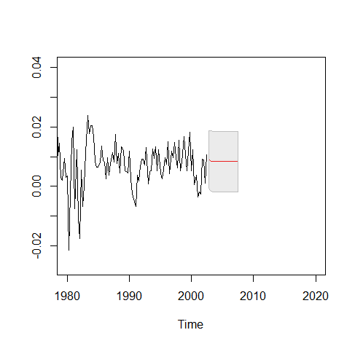
Time domain: The Big Picture
Suggest a model M($α, β,…)$
$$α=\left(α_{1},…α_{p}\right)$$
$$β=(β_{1},…, β_{q})$$
Forecasting
Model Estimation
- Estimate $α^{′}s$, $β^{′}s,…$
NO
Model diagnostics or Model selection
Are p,q,… chosen inappropriately?
Are there better models with other p,q,…
Are there better models of other kind?

Slide 24
Time domain: The Big Picture
Suggest a model M($α, β,…)$
$$α=\left(α_{1},…α_{p}\right)$$
$$β=(β_{1},…, β_{q})$$
Model Estimation
- Estimate $α^{′}s$, $β^{′}s,…$
Revise the model
Yes
Model diagnostics or Model selection
Are p,q,… chosen inappropriately?
Are there better models with other p,q,…
Are there better models of other kind?

Slide 25
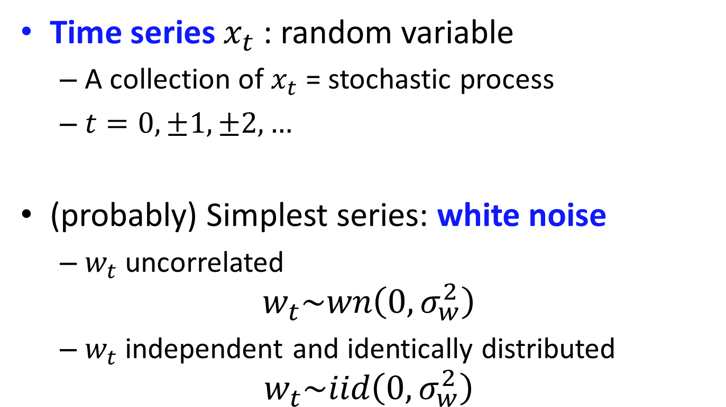
Time Series models
Time series $x_{t}$ : random variable
A collection of $x_{t}$ = stochastic process
$t=0, ±1, ±2,…$
(probably) Simplest series: white noise
$w_{t}$ uncorrelated
$$w_{t}\sim wn\left(0, σ_{w}^{2}\right)$$
$w_{t}$ independent and identically distributed
$$w_{t}\sim iid\left(0, σ_{w}^{2}\right)$$

Slide 26
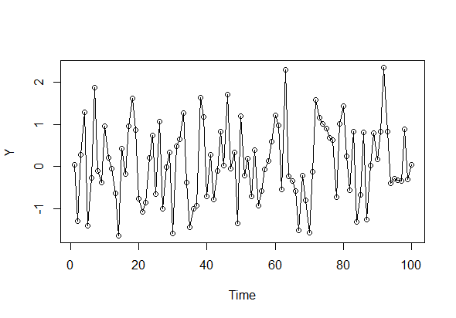

White noise
Example: $w_{t}=N(0,1)$

Slide 27
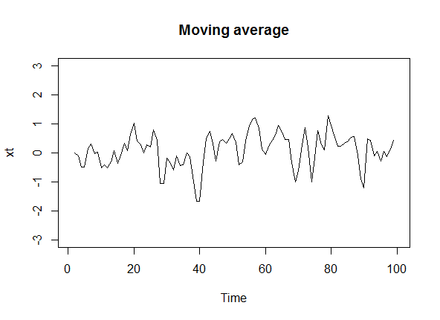


Moving average
$x_{t}=0.5w_{t}+0.2w_{t−1}+0.2w_{t+1}$
Very Interesting Fact: most of the stationary processes can be represented as a sum of the lagged white noise:
$$x_{t}=\sum_{j=−∞}^{∞}{ψ_{j}w_{t−j}}$$

Slide 28

Autoregressive model
Process is expressed in the terms of the past values of the same process
Example: AR(2) process
$$x_{t}=x_{t−1}+αx_{t−2}+w_{t}$$
Assume $x_{0}=0, x_{−1}=0$

Slide 29
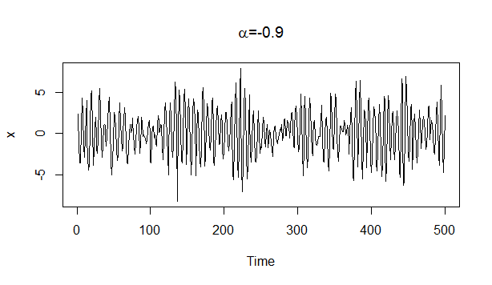
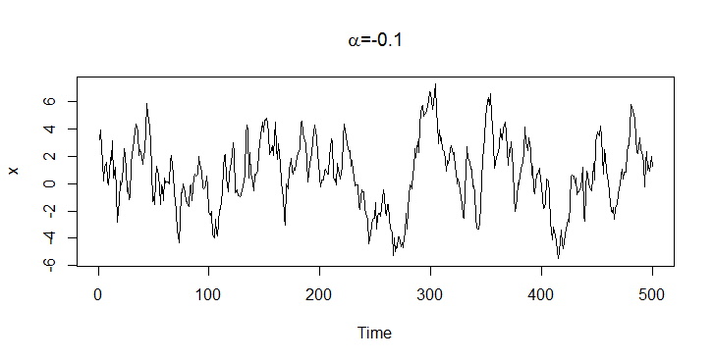
Autoregressive model

Slide 30

Random walk with drift
$$x_{t}=δ+x_{t−1}+w_{t}$$
Assume $x_{0}=0$
$δ$ is drift
$δ=0$ random walk
$$x_{t}=δt+\sum_{j=1}^{t}{w_{j}}$$

Slide 31
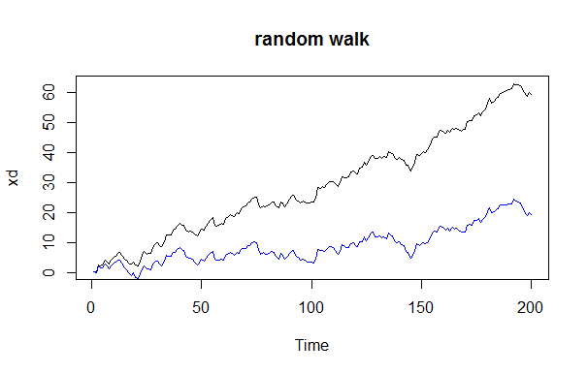

Radnom walk with drift
$δ=0$and $δ=0.2$

Slide 32
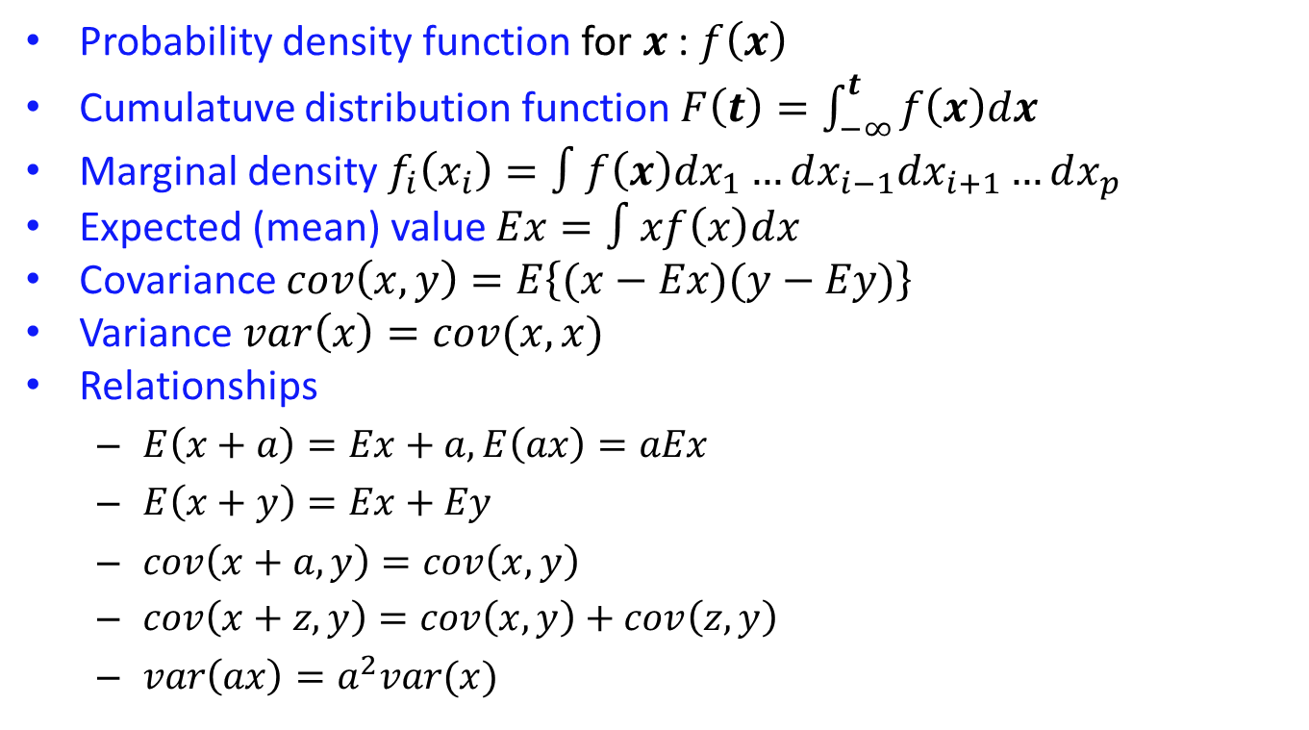
Basic statistics - reminder
Probability density function for $x$ : $f\left(x\right)$
Cumulatuve distribution function $F\left(t\right)=\int_{−∞}^{t}{f\left(x\right)dx}$
Marginal density $f_{i}\left(x_{i}\right)=∫f\left(x\right)dx_{1}…dx_{i−1}dx_{i+1}…dx_{p}$
Expected (mean) value $Ex=∫xf\left(x\right)dx$
Covariance $cov\left(x,y\right)=E\left\{(x−Ex)(y−Ey)\right\}$
Variance $var\left(x\right)=cov(x,x)$
Relationships
$E\left(x+a\right)=Ex+a, E\left(ax\right)=aEx$
$E\left(x+y\right)=Ex+Ey$
$cov\left(x+a,y\right)=cov\left(x,y\right)$
$cov\left(x+z,y\right)=cov\left(x,y\right)+cov\left(z,y\right)$
$var\left(ax\right)=a^{2}var(x)$

Slide 33
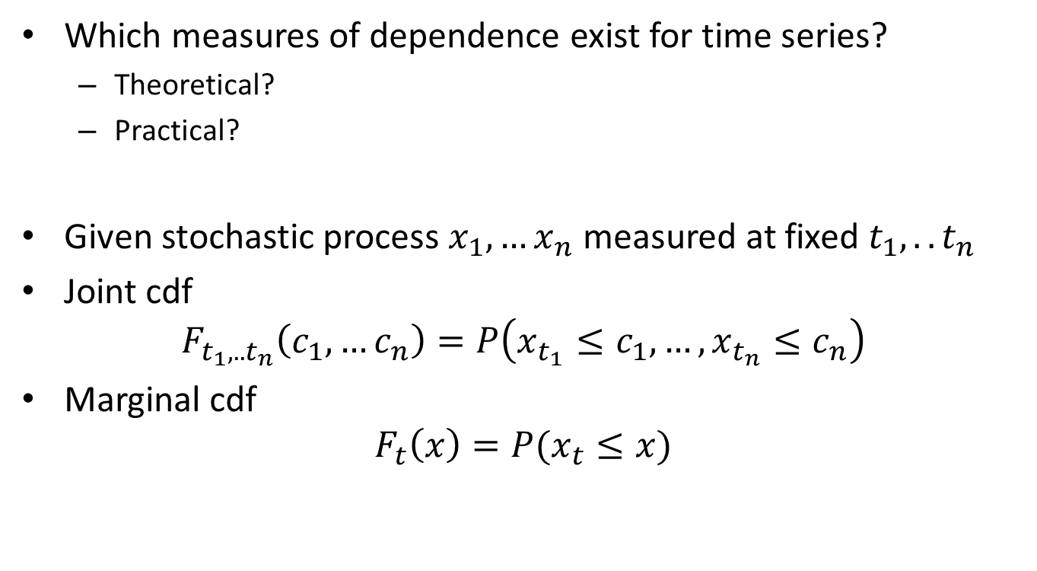
Measures of dependence
Which measures of dependence exist for time series?
Theoretical?
Practical?
Given stochastic process $x_{1},…x_{n}$ measured at fixed $t_{1},..t_{n}$
Joint cdf
$$F_{t_{1},..t_{n}}\left(c_{1},…c_{n}\right)=P\left(x_{t_{1}}≤c_{1},…,x_{t_{n}}≤c_{n}\right)$$
Marginal cdf
$$F_{t}\left(x\right)=P(x_{t}≤x)$$

Slide 34
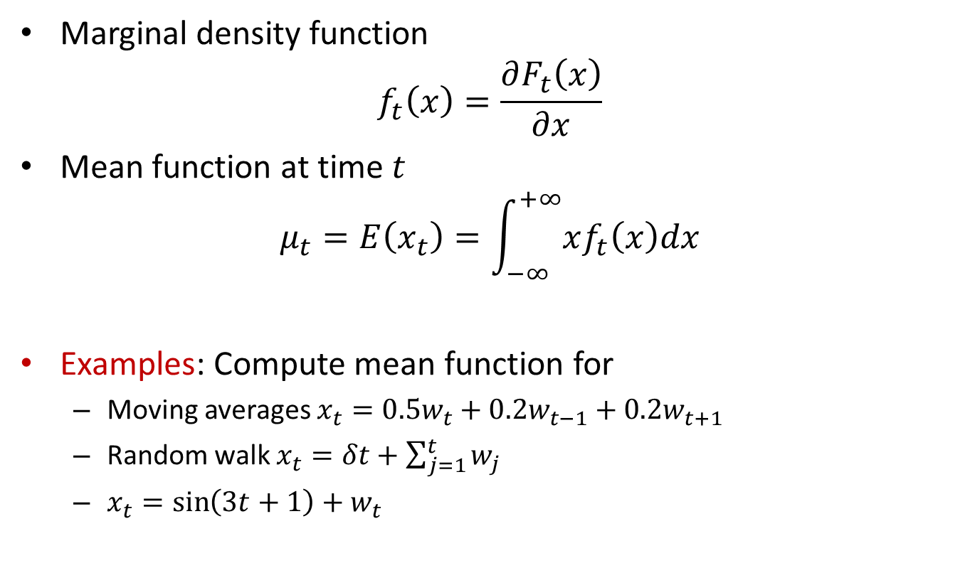
Measures of dependence
Marginal density function
$$f_{t}\left(x\right)=\frac{∂F_{t}\left(x\right)}{∂x}$$
Mean function at time $t$
$$μ_{t}=E\left(x_{t}\right)=\int_{−∞}^{+∞}{xf_{t}\left(x\right)dx}$$
Examples: Compute mean function for
Moving averages $x_{t}=0.5w_{t}+0.2w_{t−1}+0.2w_{t+1}$
Random walk $x_{t}=δt+\sum_{j=1}^{t}{w_{j}}$
$x_{t}=\sin\left(3t+1\right)+w_{t}$

Slide 35
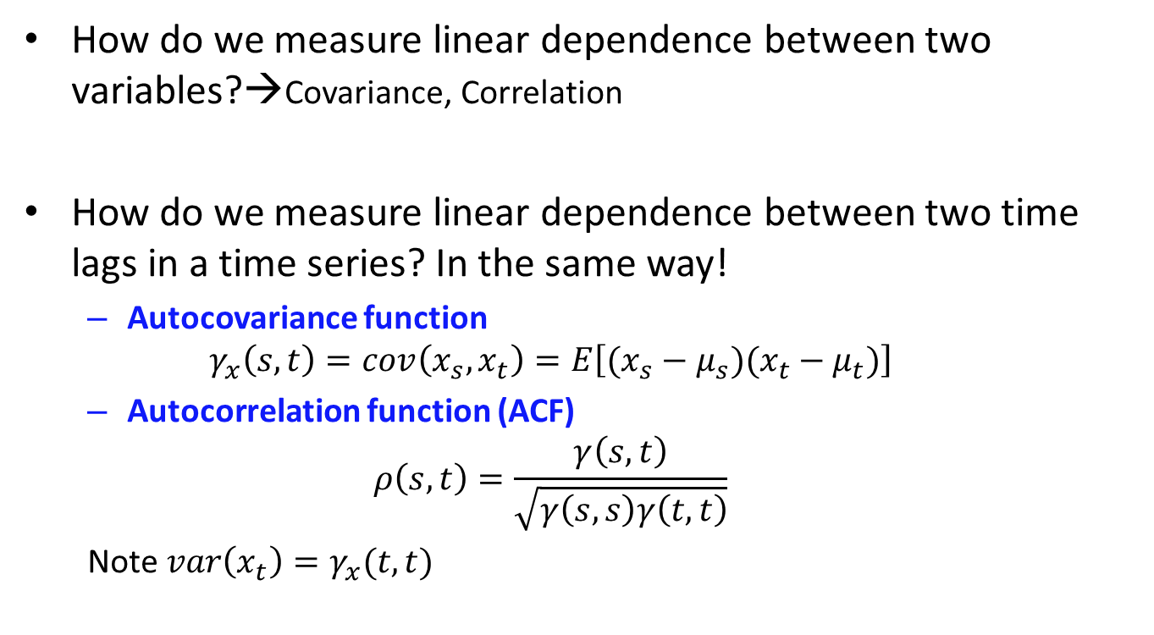
Autocovariance and ACF
How do we measure linear dependence between two variables?→Covariance, Correlation
How do we measure linear dependence between two time lags in a time series? In the same way!
Autocovariance function
$$γ_{x}\left(s,t\right)=cov\left(x_{s},x_{t}\right)=E\left[(x_{s}−μ_{s})(x_{t}−μ_{t})\right]$$
Autocorrelation function (ACF)
$$ρ\left(s,t\right)=\frac{γ\left(s,t\right)}{\sqrt{γ\left(s,s\right)γ\left(t,t\right)}}$$
Note $var\left(x_{t}\right)=γ_{x}(t,t)$

Slide 36
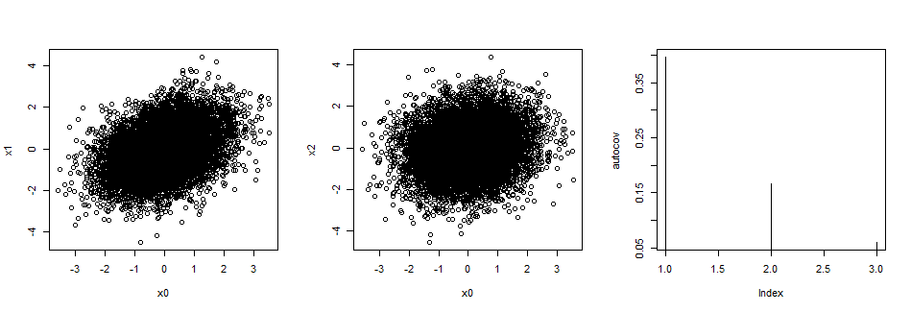

Autocovariance and ACF
Generate $x_{0},x_{1}, x_{2}$ from $x_{t}=0.4x_{t−1}+w_{t}$
See $γ\left(0,1\right), γ\left(0,2\right)$

Slide 37
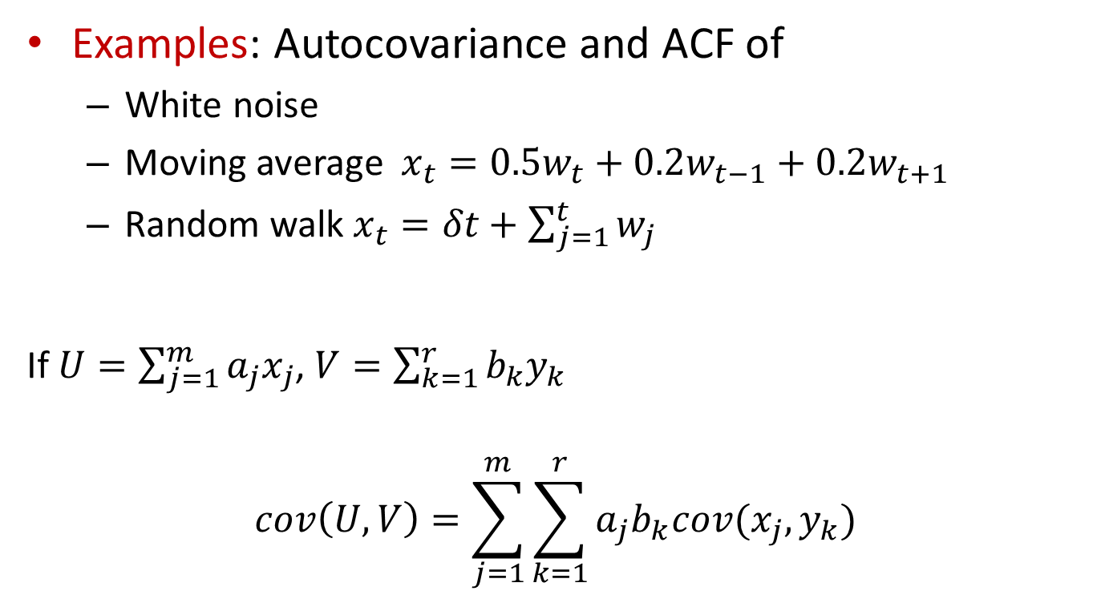
Autocovariance and ACF
Examples: Autocovariance and ACF of
White noise
Moving average $x_{t}=0.5w_{t}+0.2w_{t−1}+0.2w_{t+1}$
Random walk $x_{t}=δt+\sum_{j=1}^{t}{w_{j}}$
If $U=\sum_{j=1}^{m}{a_{j}x_{j}}$, $V=\sum_{k=1}^{r}{b_{k}y_{k}}$
$$cov\left(U,V\right)=\sum_{j=1}^{m}{\sum_{k=1}^{r}{a_{j}b_{k}cov(x_{j},y_{k})}}$$

Slide 38
Home reading
SS, ch. 1.1-1.4
TS functions: ts, plot.ts, acf, ts.intersect, filter, ts.plot

